Slide 1
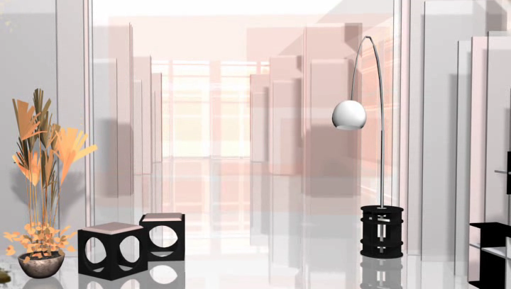
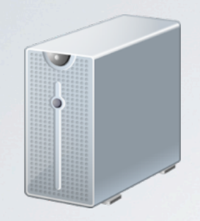
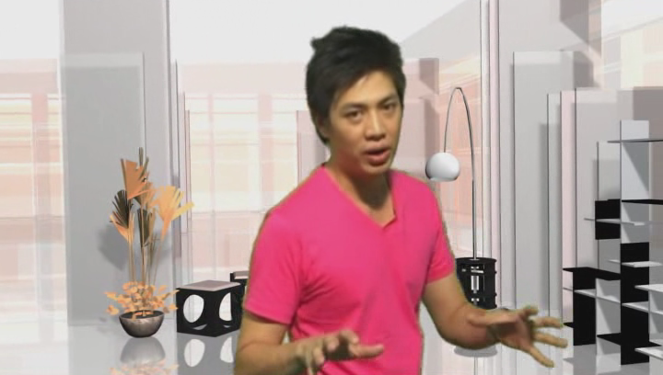
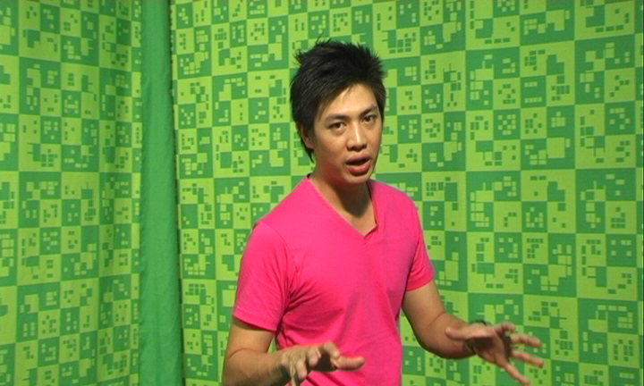
How it works?
3D virtual background
Complete video
ISLT Broadcaster
Must be very accurate
Camera position
Actor & green screen

Slide 2
Why we need camera position
ใส่ video ชื่อ untrack
เริ่มเล่นเมื่อกด
ใส่ video ชื่อ track
เริ่มเล่นเมื่อกด
Without camera position
With camera position

Slide 3
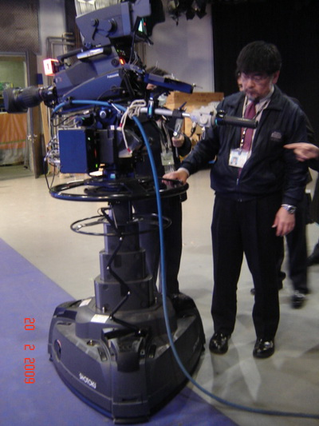
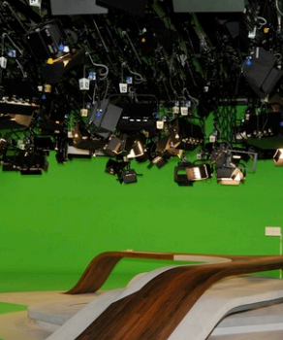
Getting “Accurate” Camera Position
Traditionally, camera tracking by “expensive” hardware
Tracking device
External sensor

Slide 4
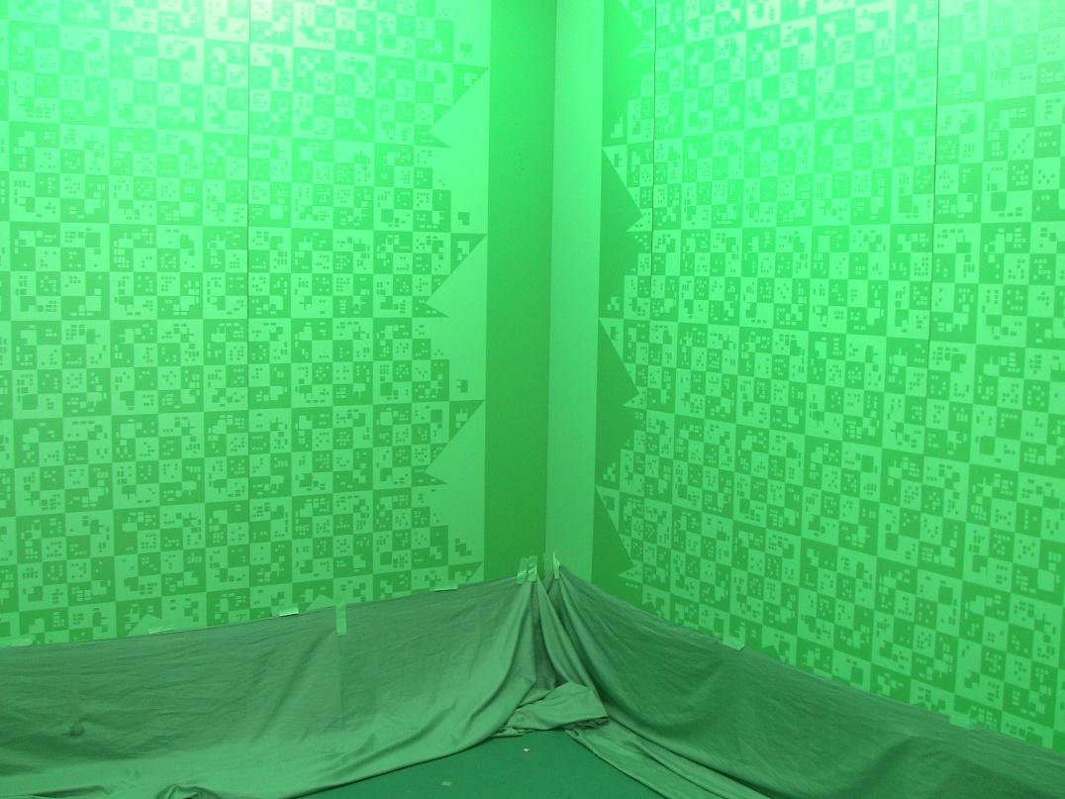
Our innovation
Do we “human” need external sensor to determine where we are?
“Eyes” and “Brain” are enough
We use Computer Vision to determine camera position
Our proprietary pattern on the green screen
No need of any external sensor ➔ TREMENDOUSLY reduce cost

Slide 5
Key Technology
Our extensive research in computer vision
Tracking Algorithm
High Definition Video Input
High Computing Power
Rise of consumer HD camcoder
Lower cost of multi-core CPU & GPU
Innovative way of getting camera position
Low cost & Accurate

Slide 6
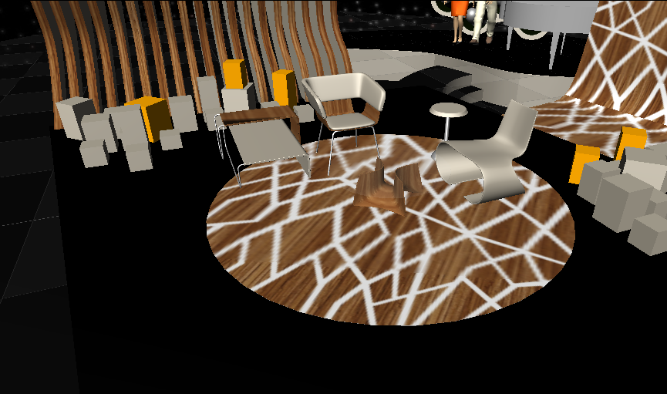
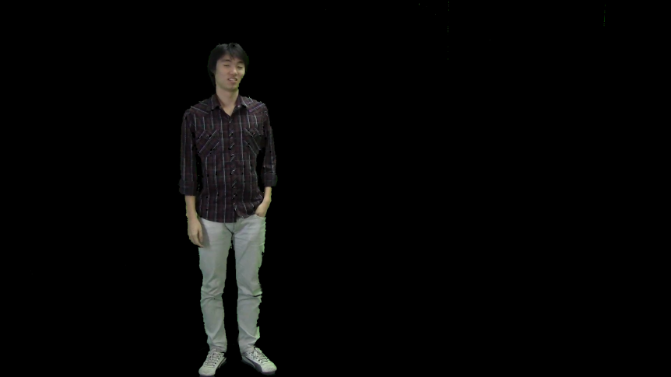
More Innovation
Formerly, there is no “interaction” between “actor” and “background”
They are just simply “image composition”
Because we don’t know “depth” of actor
Superimpose of image and rendered 3D scene

Slide 7
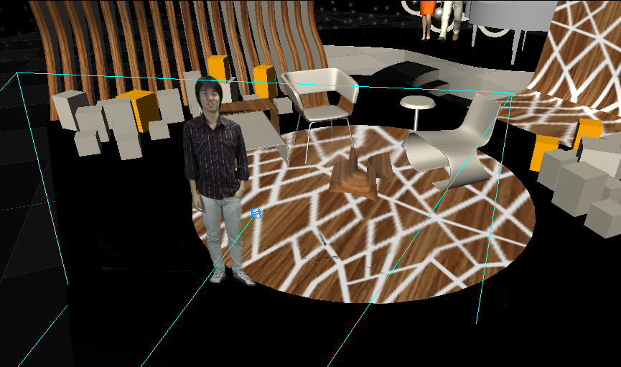
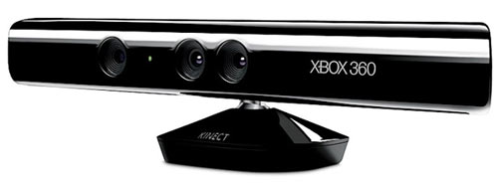
Augmented Reality
The coming of Microsoft Kinect
“low cost, accurate depth sensor”
NOW, the actor can interact with the virtual world

Slide 8
Augmented Reality Demo
ใส่ video ชื่อ pakorn เริ่มเล่นเมื่อกด

