Slide 1
Grad Student Seminar
Nattee Niparnan

Slide 2
Material Download
At http://www.nattee.net/grad_seminar
Other resource for thesis exam
http://isl2.cp.eng.chula.ac.th/?q=members

Slide 3
Thesis proposal exam
1st step

Slide 4
Why?
About 7% of CP grad student fail thesis proposal exam
Additionally, 4% of CP grad student do not take thesis proposal exam before the deadline

Slide 5
Goal of Proposal Exam?
To explain the research problem
To show that YOU can finish the research
To established a research contract between the student and the committee

Slide 6
Good Proposal
The importance of the problem is well described
The goal of the research is clear
Sufficient review
Good plan
Measurable success criteria
Well engaged in Q&A

Slide 7
Q&A Session in Proposal Exam
Q&A is a show down. It is your chance to show that you are well prepared.
Should try to answer the question as best as you can
It is OK to NOT know the answer
It is NOT OK to give up before trying
Rehearsal is the key
Get your friend to help you

Slide 8
LIVE DEMO

Slide 9
Thesis defense

Slide 10
Easier than the Proposal (Usually)
Because you know more than the committee
Unless you did not do any work…
It’s happy time
A time to celebrate a new master or phd
Stat show that much less students fail the defense

Slide 11
Goal
To show what you have done (which should be according to the contract, or better)
To analyze the result
To discuss the insight of the problem

Slide 12
Good defense
Have a claim
“I can solve the problem” , “I discovered a new method”, etc.
Defense it
Proof, experimental result, numerical result, quantitative result, etc.

Slide 13
Q&A Session in Thesis Defense
The stage is yours, show us what you have learned
We want to here the wisdom, the insight, the fun, the essence of your research

Slide 14
Possible Questions
What happen in the literature AFTER you pass the proposal exam? Anything new?
Can your result be extended to cover other problem? How can we apply it?
What is the limitation of your result?
Are there any unexpected problem in the work? How you solve it?
What is the future work?

Slide 15
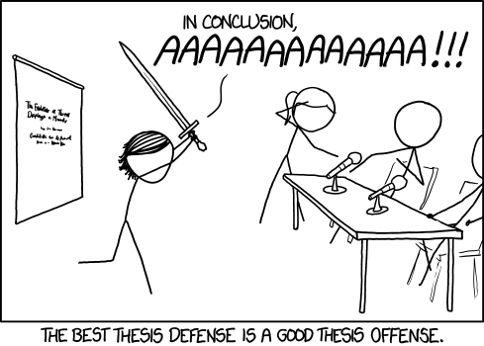
LIVE DEMO

