Slide 1
NP-Complete
Nattee Niparnan

Slide 2
Easy & Hard Problem
What is “difficulty” of problem?
Difficult for computer scientist to derive algorithm for the problem?
Difficult for computer to solve (run the derived algorithm) the problem?

Slide 3
Basic Intuition
Easy problem = Anything we can solve within O( T(x) ) where T(x) is polynomial
Hard problem = Anything else… (maybe)
More questions
Is there something unsolvable?
How to know whether the problem is hard?

Slide 4
Unsolvable Problem

Slide 5
Unsolvable
Formally, it’s called undecidable
But let’s say unsolvable for now
Something that we can’t have algorithm for it
Example:
Halting Problem

Slide 6
Halting Problem
Input: Given a program P and its input S
Output:
“Yes” when P finishes
“No” when P loops forever
To have an algorithm for halting problem
The algorithm must be able to correctly answer this question for every P and S

Slide 7
Halting is undecidable
Let us assume that there is an algorithm for the problem
Let’s say bool A(P,S) is a function that solve this problem
We construct another function
kb.cpp
bool Kaboom(x) {
if (A(x,x)) {
while (true) do ;
} else {
printf(“wow….”);
}
}

Slide 8
kb.cpp
X
X
A
X
loops forever
yes
no

Slide 9
Kaboom
What is the result of Kaboom(kb.cpp) ?

Slide 10
P and NP

Slide 11
Hard vs Easy
Which problem is hard?
Which problem is easy?
Given problem A and B, which one is easier?
This revolves around the concept of “reducability”

Slide 12
Reduction
Problem reduction: solve problem A by transform it into B
Example:
Finding k^{th} smallest element can be solved by simply sort the input
Hence, k^{th} smallest element transformed into “sorting” problem
Maximal Bipartite Matching can be solved by network flow

Slide 13
Polynomially Reducable
Let X be an instance of problem A
Let f(X) be a function that transform the instance X of problem A into an instance of problem B
If f(X) uses polynomial time to the size of X, we say that
A is polynomially reducible to B

Slide 14
Comparing “hardness” of problem
Given an instance of problem A
If that instance of A can be transformed into an instance of problem B
Which one is harder?
A or B?

Slide 15
P and NP
Class of problems
P
set of problems that we have polynomial time algorithm or better
NP
Informal: “exponent time”; set of problems that we have exponential time algorithm or better
More formal: “polynomially verifiable”; set of problems that we can verify whether its answer is correct in polynomial time (given right evidence)
Actual: “non-deterministically provable”; set of problems that can be solved by non-deterministic turing machine
i.e., every problem we have seen so far

Slide 16
Example
P
MSS, Sorting, Shortest Path, MST
NP
MSS, Sorting, Shortest Path, MST is also NP
TSP, 01-knapsack, graph coloring, longest path
And much more
NP
P

Slide 17
More Example
Shortest Path
Given a weighted graph G and two vertices u,v, find shortest path from u to v
Input: a graph G and two vertices u and v
Output: a path
Is in P,
Dijkstra’s algorithm runs in P
Is in NP
given a graph and a path, we can verify that the part is the shortest path
By running Dijkstra ourselves and compare the length with the given path

Slide 18
More Example
Graph isomorphism
Given two graphs, decides whether they are isomorphic
Input: two graphs
Output: YES or NO
Is in NP
Can be verify if a mapping is given

Slide 19
Hard vs Easy again
P contains solely easy problems
NP has easy problems + something else
Believe to be hard problems

Slide 20
Hard = NP?
No, something in NP is easy
No, something hard is not in NP
Try graph non-isomorphism
The verifiable definition for NP is when the answer is “YES”

Slide 21
Reduction

Slide 22
Decision Problem
We consider only decision problem
For simplicity
Decision problem
Limiting output to only “YES” and “NO”
Ex,
Given a graph G, does it has Euler circuit?
Given a list of integers, is their GCD 1?
Given a list of 3D boxes, do they intersect?

Slide 23
Functional and Optimization Problem
Function Problem
Output is a function
Optimization Problem
Is a function problem
Output is the best instance of the given function
Ex:
MSS, Shortest Path,

Slide 24
Equivalence to Decision Problem
All function problems can be reduced to decision problem
For polynomial output
Using polynomial time
Example
TSP
Function: Ask for the minimal path
Decision: Ask whether there exist a Hamilton path with sum weight less than or equal to X
Do binary search on the value of X
Eventually, we know the minimal X and hence the minimal path
Decision problem is everything!

Slide 25
Finally, the NP-Hard
More definition
NP-Hard
A problem such that all problems in NP is polynomially reducible to
NP-Complete
An NP-Hard that is in NP

Slide 26
Decidable
NP
NP-Hard
NPC
P

Slide 27
Reduction Example

Slide 28
Boolean expression in CNF
clause
literal
Variable : x y z
compliment: x , not x

Slide 29
SAT Problem
A decision problem
Given a Boolean expression in CNF (and of or-clause), can it be evaluated as true by assigning some value to the variable

Slide 30
Cook’s Theorem
SAT problem is NP complete
It is in NP, because given assignment, we can check whether it is true in P time
All problem in NP can be reduced to SAT
Because, essentially, all Turing machines can be described by a Boolean expression

Slide 31
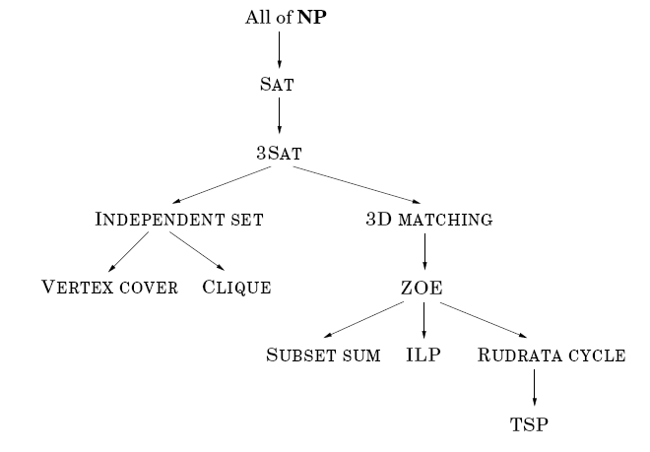
Reduction

Slide 32
Hamiltonian Path → Hamiltonian Cycle
Hamiltonian Cycle Problem
Given a graph G
Is there exists a Hamiltonian cycle
Hamiltonian Path Problem
Given a graph G and two of its vertices s and t
Is there exists a path starting at s and ends at t that contains all vertices of G?

Slide 33
Reduction

Slide 34
Correctness
Let G’ be the reduced instance of Hamiltonian cycle
When G’ has solution
Since x has only two neighbors, s and t
Just “cut” the cycle at x
When G’ does not has solution
Show instead that when G has soltuion, G’ must has solution
Does reduction use polynomial time?
yes

Slide 35
SAT → 3SAT
3SAT = SAT that each clause does not has more than 3 literals (variables + constants)
A stricter version of SAT
Subset of SAT
Seems to be easier than SAT?

Slide 36
Reduction
Rewrite SAT as 3SAT
Simply convert every clause having more than 3 lieteral to something else (that is 3SAT)
Assume that there is a clause
where k > 3
Change it to
Add new variables y₁,…y_{k-3}

Slide 37
Correctness
Let I’ be the instance of 3SAT while I be the original intance of SAT
When I’ can be made true, I must can be made true
When the right side evaluate to true, at least one of a_{i} is true
When I’ cann’t be true, I mustn’t can be made true
Conversely, When I can be made true, I’ must can be made true
When I can be made true, at least one of a_{i} is true, we must set y such that the entire is true
Simply set y₁,…,y_{i-2} as true and the rest as false

Slide 38
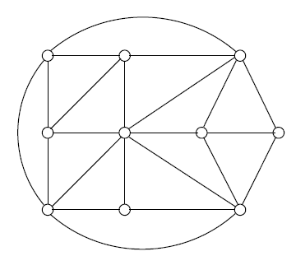
3SAT → INDEPENDENT SET
Independent Set
Given a graph G and a number k
Is there exists a set of k vertices that is not adjacent (pairwisely)
Drastically differs from 3SAT

Slide 39
Reduction
Assume that we have 3SAT instance called S
Convert it into a graph G
Each literal is a vertex
There is an edge connecting
Every vertex from the same clause
Every pair of a literal and its complement
Solve the independent set
Use k as the number of clause

Slide 40
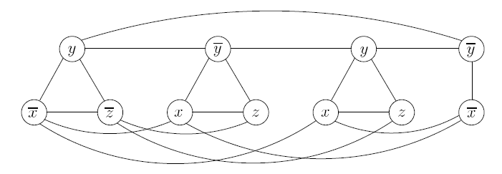
Example

Slide 41
Correctness
If G has solution, S must be satisfiable
Since each clause is maximally connected, not more than one vertex per corresponding clause is selected
Since g equals to the number of clause, it is not possible for any clause not to have its corresponding vertex selected
Since it is not possible for x and not x to be selected at the same time, the assigment is consistent
If G has no solution, S must not be satisfiable
Contrapositive again, if S can be satisfied, G has solution
Very simple…

Slide 42
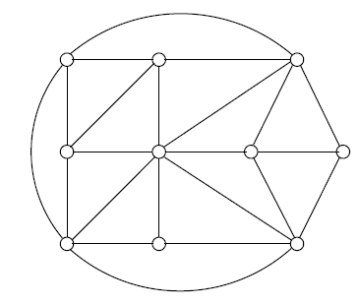
SAT → Clique
Clique
Given a graph G
Is there exists a subgraph of size k that is complete

Slide 43
Reduction
Given an instance of SAT, S
Construct a graph C
Vertex: There is a vertex for every literal in every clause
Edge:
Vertices in the same clause is not adjacent
Vertices from different clauses are always adjacent
Except for any pair of vertex of a literal and its compliment
Almost the inverse of 3SAT → independent set
Draw them in columns
Solve the clique of C
use k = number of clauses in S

Slide 44
Example
S =
C
-x
x
-y
y
y
-z
-z
z

Slide 45
Correctness
If C has solution, S must be satisfiable
The clique cannot be larger than k
The clique must contain exactly one vertex in each column
Simply assign the associated variable as true
If some variable does not appear in the clique, just assign any value
If C has no solution, S mustn’t be satisfiable
Again, use contrapositive, if S is satisfiable, C has solution
Simply choose a vertex corresponding to the one that is true in each clause
The selected vertices forms clique, since the only case when they won’t have an edge is when they are compliment

Slide 46
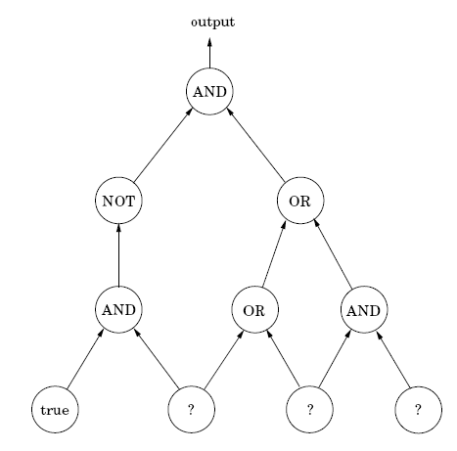
More detail on all problem to SAT
We first do CIRCUIT SAT → SAT
CIRCUIT SAT (CSAT)
Input: a boolean expression chained together
Output: YES / NO whether the expression can be satisfied

Slide 47
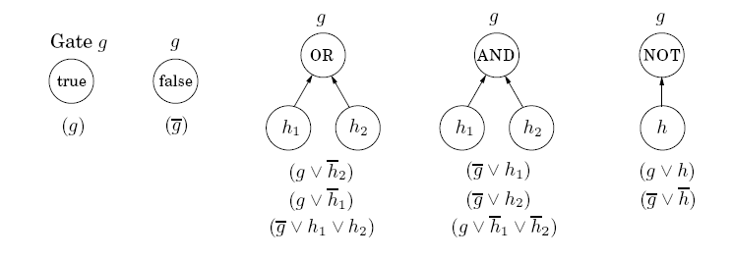
Reduction
Convert CSAT to SAT
Is this correct?

Slide 48
Cook’s theorem
Every problem in NP can be reduced to SAT

Slide 49
NP-C
There is, effectively, only one NP-C
Since it is NP-Hard
Everything in NP can be reduced to it
Including any other NP-C

Slide 50
Final Step
Every problem is simply a turing machine
Simply a logic circuit
Hence, everything is circuit sat → sat

